Slide 2
Engaging with the family courts
Using the flip chart paper and pens on your table, map out the strategic boards that influence the family court and any key stakeholders. This could be both locally and nationally.
10 minute activity

Slide 3
Workshop timings
Time | Activity time | Activity
16:00 | 10 minutes | Mapping strategic boards and stakeholders
16:10 | 10 minutes | Feedback
16:20 | 5 minutes | IDAS Intro
16:25 | 10 minutes | Women’s Aid: Two Years too long
16:35 | 15 minutes | Sharing best practice and achievements
16:50 | 10 minutes | Current concerns and FJB priorities
17:00 | 15 minutes | Opportunities for engagement
17:15 | 15 minutes | Action points
17:00 | ENDS

Slide 4
Feedback
Is your organisation represented on the local family justice board?
Who are the key stakeholders in the family court system?
Home Office
Ministry of Justice
Department of Education
HMCTS
VAWG Sector Meetings
Family Justice Board
Family Justice Council
Judiciary
Cafcass
Young People’s Family Justice Board
Women’s Aid Family Court Working Group
Domestic Abuse Commissioner
Reporting mechanisms
Courts
Domestic Abuse Strategy Group
Local Family Justice Board
Rights of Women
Parental Alienation Steering Group
Local Authority
Police
Domestic Abuse & Family Court Sub Group

Slide 5
Who we Are
IDAS is the leading specialist domestic abuse charity in Yorkshire.
IDAS also offer advice and support to people who have been affected by sexual violence and abuse.
Notes:
IDAS is the leading specialist domestic abuse charity in Yorkshire. IDAS also offer advice and support to people who have been affected by sexual violence and abuse.
IDAS is the only specialist domestic abuse charity in North Yorkshire. IDAS also supports people in Barnsley and Sheffield.
In North Yorkshire, IDAS also offer advice and support to people who have been affected by sexual violence.
We tackle abuse and sexual violence through practical advocacy services and keep people safe through the criminal justice service as well as providing emotional support.
https://www.idas.org.uk/contact/make-a-referral/

Slide 6
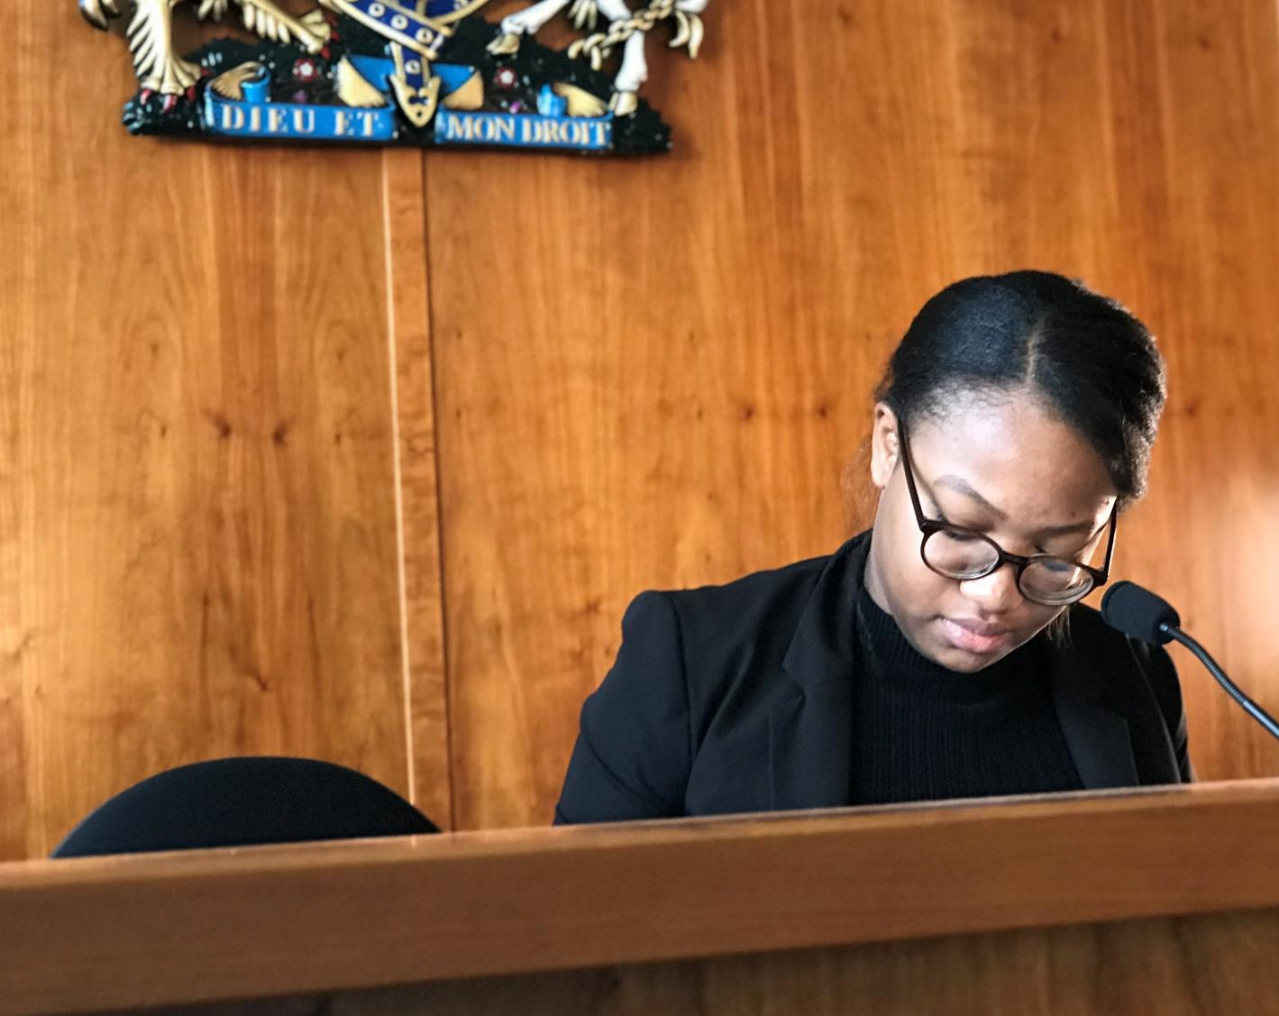
Child & Family Court Project
From October 2018
To improve the experience and safeguarding of victims/survivors of domestic abuse in respect of Child and Family Court proceedings
safe lives, free from abuse and violence
Notes:
At the beginning of October 2018, I began a six month project to look into the experience and safeguarding of survivors of domestic abuse and their children, in respect of child and Family Court Proceedings.
The overarching methodology was to identify concerns, investigate these so that recommendations could be made and, where possible, act to address them.
I would like to take this opportunity to thank everyone who has given so generously of their time and shown such commitment and enthusiasm for the work. It has been a privilege to work on this project with the support of so many people from across the county who are all equally dedicated to improving the experience and safeguarding of survivors and their children. A real strength has been the willingness to work together.
In this presentation, I will provide an overview of some of the concerns that have been identified and the work that has been done to address them. If you would like to know more about the project following the presentation, please don’t hesitate to get in touch.

Slide 7
Support for people attending court
CLOCK project
Increased pro bono support locally
Family Court Website
Information packs
Notes:
A key concern has been the ability of survivors to access the justice system and the lack of parity when one party is represented and the other is not. The pressure on the courts created by the rise in people representing themselves in courts is not to be underestimated. The impact of one or both parties not being represented is detrimental to the case and the ability for the Judge to make a safe order.
Confusion over availability of Legal Aid, with solicitors reticent to apply, if there is a chance it could be turned down, to preserve contracts
Pay for legal aid work is very low, around £50/hour
National services including NCDV, DV Assist and National Legal Service preparing witness statements, questionable service.
Solicitors with Legal Aid contracts in decline
If legal support is unaffordable and Legal Aid unavailable there are very limited options for people to get support
Lack of clear guidance or support if survivors can’t access the support of a solicitor
Disproportionate impact on vulnerable people, disabled people, those with low literacy levels or with English as an additional language
Obtaining support under exceptional circumstances is near impossible
In York and North Yorkshire this is of particular concern because of the lack of support services to plug the gap. Whilst not unique in the UK, there are significant issues presented by the absence of a PSU or similar support organisation in the courts. Citizens Advice York and some Advocacy services attempt to help here but their capacity is seriously limited and their services only available in York.

Slide 8
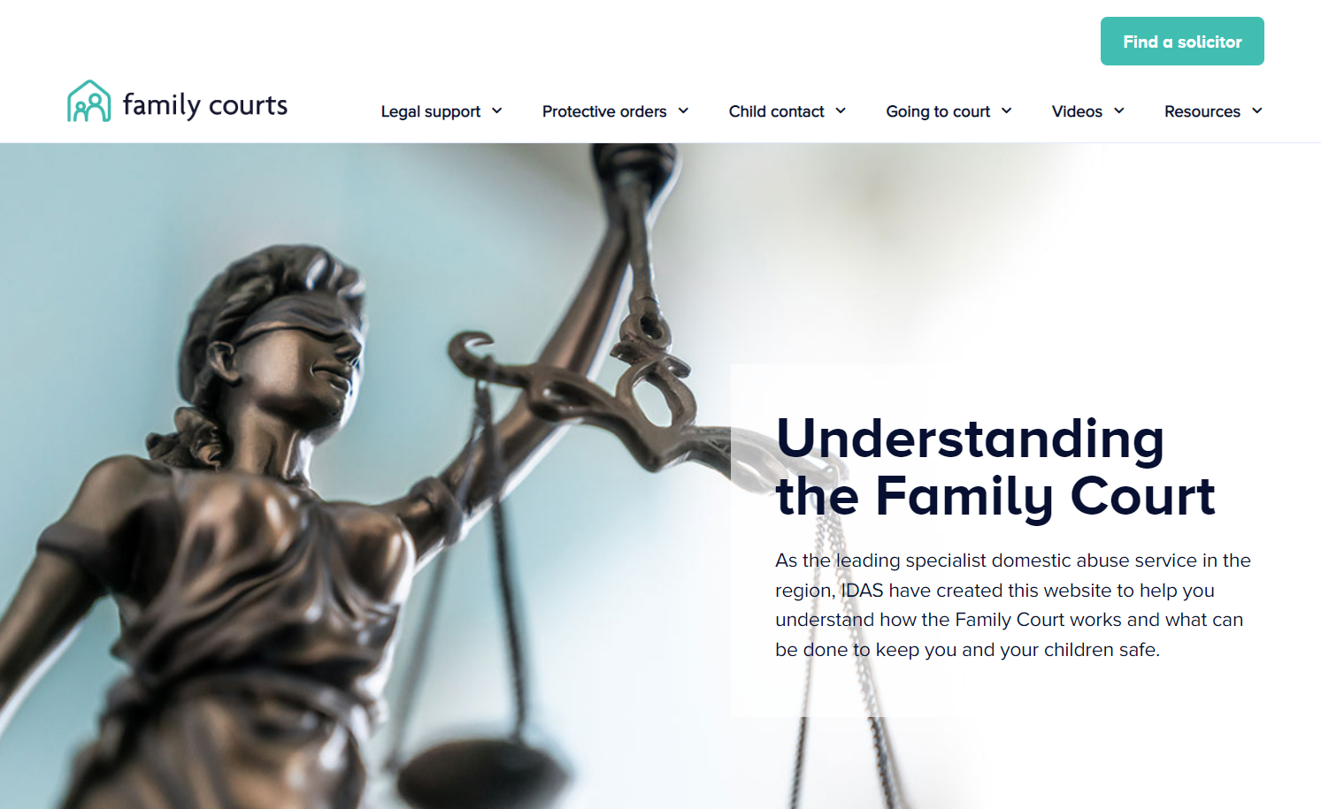
Notes:
https://familycourts.idas.org.uk/

Slide 9
Domestic Abuse Best Practice:
Special measures
Attendance at LFJB
Domestic Abuse & Family Court Working Group/ LFJB subgroup
Coercive & controlling behaviour training
Input at LFJB Conference
Notes:
As a result of the consultations and surveys, a number of concerns were identified, these included:
Understanding of domestic abuse
Although there have been strides forward in understanding of domestic abuse a key theme of the review has been that a lack of understanding of domestic abuse still prevails.
Lack of available data to understand the performance of the system in relation to domestic abuse
Survivors report that their efforts to safeguard themselves and their children are seen as obstructive and there is little appreciation of the conflicting messages that survivors receive from different authorities and organisations
There are limited opportunities to identify domestic abuse
Safeguarding checks and Police disclosures are not thorough enough – civil disclosures
Fear of perpetrator - availability of special measures
Challenges of proving domestic abuse
Continued abuse through the courts
Cases being brought back year on year, the impact of this on survivors and their children
Non-abusive parent’s fear of continued abuse and safeguarding concerns for child seen as obstructive and causing ‘high-conflict’ resulting in alienation.
Perpetrators alleging mental health concerns to discredit non abusive parents allegations and their ability to care for children
Children resisting court ordered contact but still being enforced
Parents with safeguarding concerns about contact have little support
Pressure to progress to unsupervised contact
Child’s voice not being heard
Impact on survivors and children
Financial impact
Time and resources
Retraumatising
Some give up and wait until their child is considered old enough to “vote with their feet”

Slide 10
Links between civil and family courts:
Improving Police understanding of and response to NMOs
Disclosure processes
Project Shield
safe lives, free from abuse and violence
Notes:
Non-molestation orders were also a particular are of interest due to their cross over between civil and criminal and the bearing they have on child arrangement orders. A number of concerns were raised and in this area the project was able to secure some ‘quick wins’.
Police and Social Care recommending them without understanding limitations, costs and timescales
Serving of non-mols to the Police
Recording of Non-mols on the Police systems to enable an effective response and enforcement
Enforcement and dealing with breaches
Lack of data

Slide 11
Key Points ‘Two years too long report’

Slide 12
Women’s Aid ‘Two years too long report’
Report maps the progress that has occurred over the last two years to learn from the Harm Panel’s findings and implement its recommendations.
Also asks what work is still to be done
Ends with a call to action and recommendations on the changes that remain outstanding in order for the family courts to be safe for survivors of and their children.

Slide 13
Key findings include:
The optimism and hope that survivors felt after the Harm Report’s publication has been eroded during the last two years, with the lack of progress on actioning the report’s findings leaving them disillusioned and disappointed.
Many family court professionals’ understanding of coercive and controlling behaviour and perpetrators’ use of family proceedings as a form of post-separation abuse is still inadequate.
Survivors feel their experiences have been minimised and ignored, and that as mothers they are trapped within a continuum of blame, facing contradictory accusations both of failing to protect their children from the perpetrator, and failing to facilitate contact between child and perpetrator.
The pro-contact culture in the family courts is as strong as ever, and children’s voices, wishes and feelings continue to be ignored.
Children continue to be traumatised and harmed by being forced to have unsafe contact with an abusive parent.

Slide 14
Key findings cont….
Survivors continue to be accused of “parental alienation” or “alienating behaviours” when they raise concerns about unsafe contact between a child and an abusive parent. Several of the survivors we spoke to had had their children removed from them as a result.
Recent Court of Appeal case law and guidance for judges and magistrates has left survivors feeling disappointed and disheartened. They fear that progress on improving the way domestic abuse is understood and dealt with in the family courts is stalling or even reversing.
Support services raised concerns about the extra barriers faced by Black and minoritised women, women with no recourse to public funds, women whose first language is not English, and Deaf and disabled women.
Some of these barriers centre around a lack of accessibility, and the courts’ failures to put measures in place to ensure that all parties can participate equally. Others are caused by limited understanding and awareness of the particular forms of harm these survivors have experienced, and the ways that structural discrimination impacts on their interactions with family court processes and professionals.

Slide 15
Progress so far
Section two of the report covers progress so far in implementing the harm panel’s recommendations, and covers:
Domestic Abuse Act provisions
Pathfinder pilots (trialling a new approach)
The Domestic Abuse Commissioner’s monitoring and reporting mechanism
Review of the legal presumption of parental involvement
Review of domestic abuse perpetrator programmes
Cafcass domestic abuse learning and improvement plan
Positive case law

Slide 16
Work still to be done (with contributions from specialist services
Section three of the report draws on the experiences of survivors of domestic abuse and the specialist services supporting them.
Twenty-one survivors and ten services from across England responded to a call for evidence.
In order to meet the criteria set out in the call for evidence, survivors needed to have been engaged in private law children’s proceedings since June 2020, and their case needed to be now closed.
Specialist support services were asked to submit evidence only about their experiences of supporting survivors in the family courts since June 2020.

Slide 17
‘Two years on’ What services are telling us
Still hearing about:
The minimisation of domestic abuse and pro contact culture
Unsafe approaches to child contact being taken by some professionals within the family justice system including family judges.
A lot of lip-service about how seriously the court takes domestic abuse but this is not being felt in the lower courts where it’s business as usual.”
Victims of domestic abuse being failed by the court is exacerbated by the pandemic and the impact this has on increasing backlogs.
A lack of resources across the entire system is making it harder for professionals to keep women and children safe
Women still feeling that they are not being heard.

Slide 18
Two years on’ What services are telling us
Recent example:
Case:
Court has measures in place to reduce the backlog.
Resulted in the safeguarding letter being prepared without speaking to either parent
A section 7 report being ordered without a hearing and without the court deciding whether a fact finding was necessary
The Cafcass officer making recommendations without disputed allegations being determined.
This all happened before a single hearing had taken place resulting in the mother feeling that the court had no interest in what she had to say.” (Senior Legal Officer, Rights of Women)

Slide 19
Survivor’s Voice
“I don’t believe anything has changed yet. Following the recommendations that were made by the harm panel – children are still being pushed into contact arrangements with people that frighten them and victims and their families are being accused of parental alienation for wanting to break cycles of abuse and ensure contact is safe.
Whilst some individual social workers appear to be more aware of the risks and trying to advocate for family safety, it doesn’t appear to be translating into Cafcass reports or court judgments yet.”
(Refuge worker, Women’s Aid member service)

Slide 20
Key points made by member services
Family court professionals’ understanding of the impact of domestic abuse on children, and particularly of coercive control, is still not good enough
Understanding of the ways that perpetrators use family proceedings as a strategy of post-separation abuse is also not good enough.
The ‘pro-contact’ culture remains strong and children’s voices, wishes and feelings aren’t being listened to
There is still an underlying culture of mother blaming and misogyny in the family courts

Slide 21
Key points made by member services
Survivors’ intersectional identities and experiences are not understood or addressed
Survivors continue to face barriers to accessing legal aid and incur huge debts as a result of family proceedings
Specialist services have an important role to play in improving awareness of the new measures brought in by the Domestic Abuse Act
The expertise of specialist support services needs to be valued and utilised by the family courts – we still have to fight to be in those spaces.
Family court proceedings continue to be trauma-inducing, rather than trauma-aware

Slide 22
‘Two Years on’
Calling on:
The government
Family Justice Board
President of the Family Division of the High Court
Judicial College
Her Majesty's Courts and Tribunals Service (HMCTS)
Cafcass
To scale up and reinvigorate plans to implement the Harm Panel’s recommendations in full.

Slide 23
Recommendations include:
The government should urgently amend Section 1(2A) of the Children Act 1989
to make clear that the presumption of parental involvement does not apply in cases involving allegations of domestic abuse or other forms of serious harm.
The Judicial College should work collaboratively with specialist domestic abuse organisations to improve judicial understanding and awareness around domestic abuse
All agencies with responsibility for training family court professionals should work together on the multi-disciplinary training recommended by the Harm Panel.
This training must have a specific focus on coercive and controlling behaviour, including the ways that perpetrators utilise private law children proceedings as part of this behaviour.

Slide 24
Recommendations include:
Learning and best practice from the Pathfinder pilots should be developed and considered as a priority
The roll out of this approach should be a key priority for the government, who should ensure that it is adequately and sustainably funded.
Enhanced action is needed by the government, the judiciary, and HMCTS to ensure that the newly introduced provisions around special measures in the family courts are understood and implemented at ground level.

Slide 25
Recommendations include:
The pilot phase of the monitoring and reporting mechanism developed by the offices of the Domestic Abuse Commissioner and the Victims’ Commissioner should be adequately resourced,
The government should ensure that any new domestic abuse perpetrator programme commissioning approach is effectively focused on reducing harm for children and families affected by domestic abuse.
The government should prioritise the Harm Panel’s recommendations around the additional investment needed across a range of areas.
The government should also act on the Harm Panel’s recommendation that legal aid be made available to both alleged perpetrators and victims of domestic abuse, in the best interests of the child.

Slide 26
Recommendations include:
Urgent action is needed by the government, Family Division of the High Court, the Judicial College, Magistrates Association and Cafcass to ensure that family court professionals are aware of, and able to identify, allegations of “parental alienation” being made by perpetrators to undermine, obscure and deflect from their own domestic abuse or other forms of serious harm.
Family court professionals should draw on the expertise of ‘by and for’ specialist domestic abuse support services in order to gain a better understanding of the specific experiences and needs of survivors and children from marginalised and minoritised groups.
Better recognition of, and funding for, the support offered by specialist domestic abuse organisations to survivors and children involved in family court proceedings

Slide 27
Recommendations include:
Women’s Aid calls on the Lord Chief Justice, Family Division of the High Court and the government to develop a transparent process where complaints about poor decision making in cases involving domestic abuse or other forms of serious harm can be considered without cost to vulnerable victims and survivors.

Slide 28
Sharing best practice & achievements
A discussion about where improvements have been made and the role of the sector in driving forward change to improve the experience and safeguarding for survivors and their children.
10 minute activity

Slide 29
Current sector concerns
Parental alienation and use of ‘experts’
Cross examination of victims and the provisions in the DA Act 2021
Family hubs
DAPP Programmes suspended till 2024/25
The use of ISW to prepare reports for court
Understanding of CCB and the slow roll out of judicial training
Lack of trauma informed approaches
Pathfinder courts
Limited availability of Legal Aid continues to limit access to justice
Training for judiciary on DA Act and new offences, inc. non-fatal strangulation
Complaints and appeals
February 2022

Slide 30
Family Justice Board Priorities
Private Law Priorities
government and all partners understanding and influencing wider societal views on separation and the use of the courts;
increasing efficiencies in the private law process and
better support for local areas to scrutinise their performance challenges and share best practice
Public Law Priorities
identifying and addressing the drivers and impact of children’s cases that are in the family justice system the longest;
understanding data and practice around short-notice applications and
improving practice at the pre-proceedings stage.
February 2022

Slide 31
Opportunities for engagement
Identify 3 areas for improvement
Identify stakeholders who can influence this change
Identify the strategic meetings where change can be proposed
Identify which of these three areas are most likely to be successful
10 minute activity

Slide 32
Action points
What should our onward actions be?
10 minute activity

Slide 33
Thank you for attending
Carmel.offord@idas.org.uk
J.Kilburn@womensaid.org.uk

